Slide 1
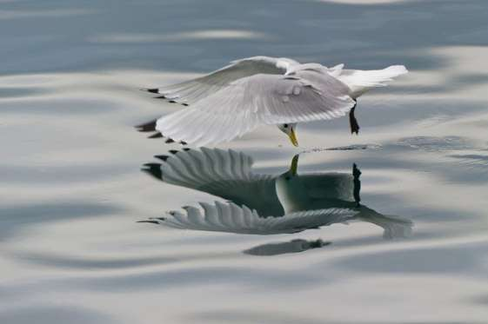
Homeostasis
Professor Deepthi de Silva
Department of Physiology

Slide 2
At the end of the lecture you should be able to
Explain the term homeostasis
Know the normal range for body temperature, plasma [Na⁺], [K⁺] & [glucose]
Outline the mechanisms involved in water, electrolyte and glucose homeostasis

Slide 3
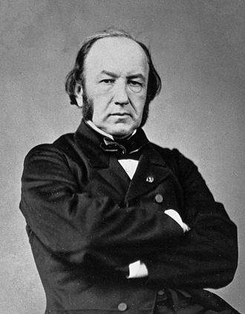
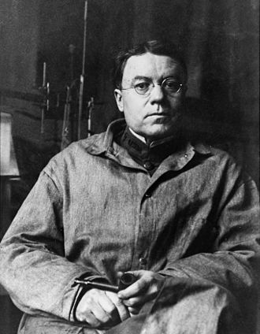
Homeostasis
“All vital mechanisms…. have only one object,
that of preserving constant the conditions of life in the internal environment”
Claude Bernard
1813-1878
Homeostasis: “the physiological arrangements which serve to restore the normal state once it has been disturbed”
Walter Cannon
1871-1945

Slide 4
Why do we need homeostasis?
All of the body’s functions occur within
a ‘normal range’
Alteration of this normal range causes loss of normal function
The body has a way (mechanism) for
maintaining the normal range.
This is called homeostasis

Slide 5
Importance of homeostasis
Temperature
36.3°C -37.1°C
pH
7.34-7.45
Serum K⁺ concentration
3.5-5.0mEq/L
Plasma osmolality
280-290mosm/kg
Change will cause inactivation of enzymes
Change will cause
resting membrane
potential to be altered
Change will cause
alteration in cell volume and osmolality

Slide 6
Control of Homeostasis
Mostly negative feedback systems
Normal
-ve
feedback
Body able to change normal setting
e.g temperature set point in fever

Slide 7
Input
(what is happening)
Feedback
“Afferent”
information
Control centre
(Sets the normal range)
“Efferent”
Output
Action necessary to correct alterations from normal range

Slide 8
Temperature receptors
“Sensor”
Hypothalamus
(part of the brain)
Temperature set point
37° C
Effect
Temperature <37° C
Increase heat generation
Reduce heat loss
Temperature >37° C
Reduce heat generation
Increase heat loss

Slide 9
Temperature receptors
“Sensor”
Negative feedback
Stop heat generation &
heat saving mechanisms
Hypothalamus
(part of the brain)
Temperature set point
37° C
Hypothalamus
Effect
Temperature receptors
Temperature <37° C
Increase heat generation
Reduce heat loss
Temperature
rises

Slide 10
Fluid Balance in the Body
CONTROL
Thirst
Urine output
Intake
Output
Intake -
Drinks 1500 ml
H₂O in solid foods 500 ml
Metabolic H₂O 500 ml
2500
Output
Urine 1500 ml
Lungs (expired air) 400 ml
Skin 500 ml
Faeces 100 ml
2500

Slide 11
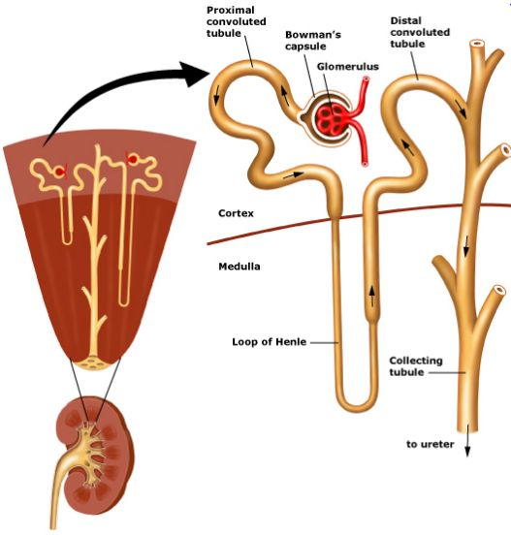
Daily Turnover of Fluid - Kidneys
Renal blood flow 11,700L/day
Glomerular filtration rate (GFR) 180 L/day
Rate of urine flow about 1.5L/day
> 99% of water filtered in the kidney is reabsorbed

Slide 12
Daily Turnover of Fluid
In the gastrointestinal system :
Saliva - 1500 ml
Gastric juice - 2500 ml
Bile - 500 ml
Pancreatic juice - 700 ml
Intestinal juice - 3000 ml
- 8200 ml
Of this only 100 - 200 ml is lost per day

Slide 13
Regulation of water balance
H₂O drinking
Thirst centre
(Hypothalamus)
Raised
plasma
osmolality
Osmoreceptors
H₂O loss
Reduced
plasma
volume
Volume
receptors
ADH
Kidneys
↓ Urine output
Reabsorb
water

Slide 14
What Is the Minimum Water Loss?
Urine - 400 ml/day
Skin - 500 ml/day
Respiratory tract - 400 ml/day
Faeces - 10 ml/day
Total obligatory loss - 1400ml/day
To maintain water balance a minimum of 1400 ml/day has to be taken

Slide 15
Sodium balance
Main regulator of extracellular fluid volume
Hyponatraemia [Na+] <138mmol/L Hypernatraemia [Na⁺] >142mmol/L
Sodium balance regulated by kidney
Hormones
  Aldosterone
  Atrial natriuretic peptide (ANP)

Slide 16
Hormonal regulation of
Sodium balance in the body
Sodium deficit
↓ BP
↑ Renin
in kidneys
↓ [Na⁺]
↓ ECF vol.
↑ Angiotensin II
Kidney
tubules
↑ Na⁺
reabsorption
↑ Aldosterone
↓ Urinary Na⁺

Slide 17
Hormonal regulation of
Sodium balance in the body
Sodium overload
↑ BP
Renin secret^{n}
reduced in kidneys
↑ [Na⁺]
↑ ECF vol.
ANP
from Heart
↓ Angiotensin II
↓ Na⁺
reabsorption
↓ Aldosterone
Natriuresis

Slide 18
Glucose Homeostasis
Insulin
Less than normal range
Normal range
70-110mg/dL
3.9-6.1mmol/L
Hyperglycaemia
Hypoglyceamia
Greater than normal range
Glucagon
Catecholamines
Growth hormone
Cortisol
Thyroid hormones

Slide 19
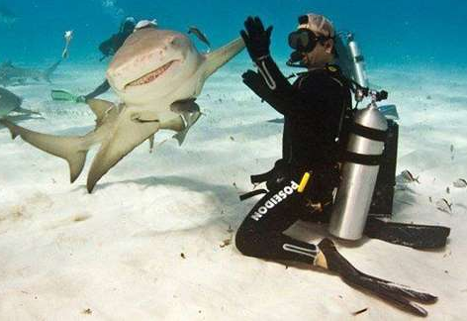
Can you?
Explain the term homeostasis
State the normal range for body temperature, plasma [Na⁺], [K⁺] & [glucose]
Outline the mechanisms involved in water, electrolyte and glucose homeostasis

